Slide 1
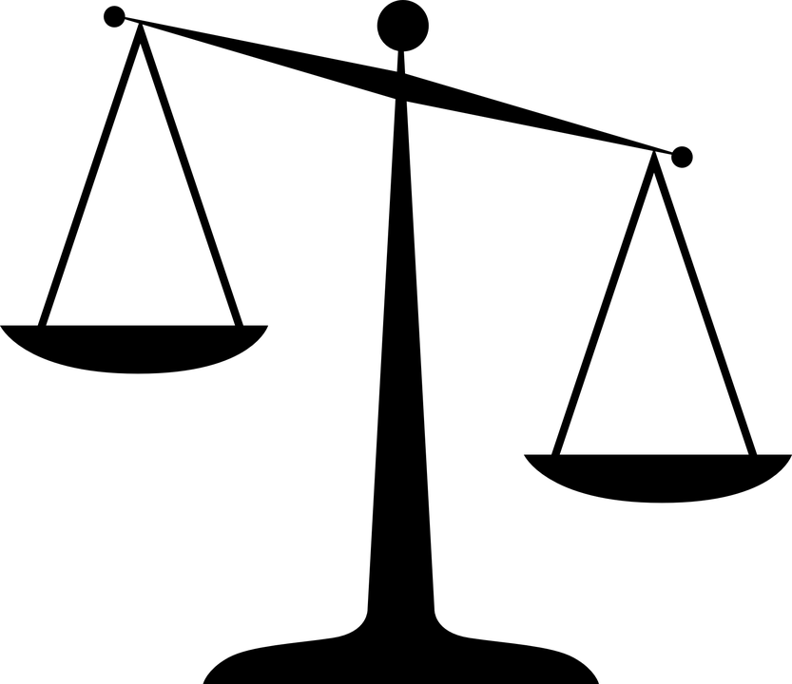
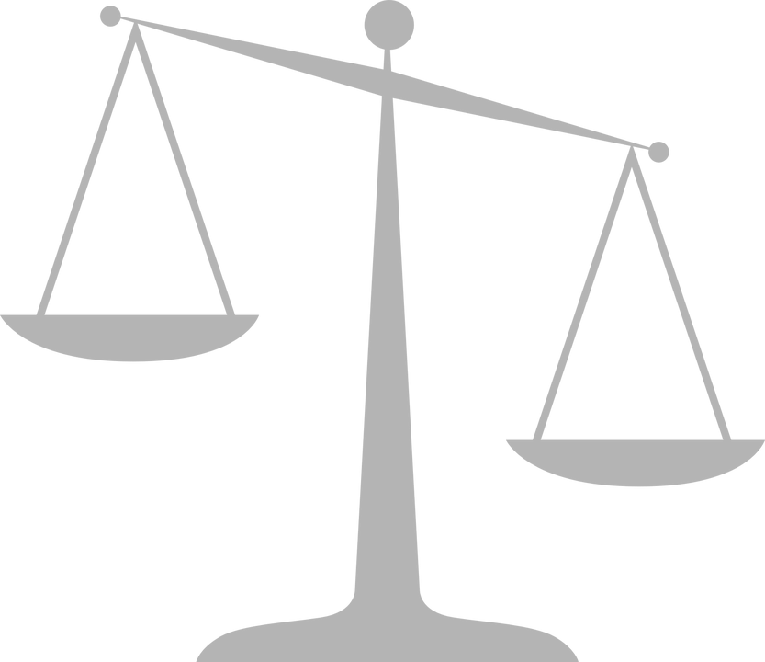
HISTORICAL SIGNIFICANCE
Historical Thinking
Concepts

Slide 2
TODAY’S PURPOSE
Understand that…
Historical significance is constructed based on criteria.
Events, people or developments have historical significance if they resulted in deep changes, for many people, over long periods of time.

Slide 3
HISTORICAL SIGNIFICANCE
Here is a list of events that occurred in the last 10 years.
With your partner, rank them from most to least significant.
Apple becomes first trillion-dollar company
Osama Bin Laden is killed
Syrian Civil War
Barack Obama becomes US President
Justin Trudeau becomes Canadian Prime Minister
Paris Climate Agreement
Your teacher’s birthday
Arianna Grande releases “thank u, next” music video
Invention of Instagram
Donald Trump becomes US President

Slide 4
HISTORICAL SIGNIFICANCE
Now that you are finished ranking the events…
With your partner, walk around the room and have a “mini-debate” with other partners about what should be first on the list – the most significant event.
With your partner, walk around the room and have a “mini-debate” with other partners about what should be last on the list – the least significant event.

Slide 5
DEBATE DEBRIEF
Were you (or someone you debated with) biased towards the events that personally affected you or your country?
Is there a way to judge something objectively instead of just using our own personal biases?
We need to develop criteria!
With a partner or small group, try to think of some criteria we can use to decide if an event or person is significant.
One example might be: the event affected many people.
Notes:
People generally identify events relating to their country or them personally as more significant than others. So significance can be tricky because some things that are highly significant to some people (e.g. Justin Trudeau’s election to Canadians) are not very significant to others (Justin Trudeau’s election to Americans).
This is why we need some criteria to judge significance – that way we can try to be more objective in our judgments.

Slide 6
HISTORICAL SIGNIFICANCE
Criteria for historical significance…
Depth of impact: how deeply felt was the event to people involved?
Scope of impact: How many people were affected by the event?
Duration of impact: How long was the event felt for? (is it still being felt today?)

Slide 7
HISTORICAL SIGNIFICANCE
Discussion Questions
Now, go back to your list of 10 events. Does your top choice still make sense given the criteria? Or do you want to change it? Explain.
Which event on our list had the deepest impact, for the most people, over the longest duration?
Which event on our list was the least significant based on these criteria?

Slide 8
THE LEAST YOU NEED TO KNOW…
Historical significance is constructed based on criteria.
The criteria for historical significance include:
Depth of impact: how deeply felt was the event by everyone involved?
Scope of impact: how many people were affected by the event or person?
Duration of impact: how long were the effects of the event or person felt for? (are they still felt today?)

Slide 9
ESTABLISHING HISTORICAL SIGNIFICANCE
Does this event have serious, long-lasting consequences for many people?
Does this event reveal or shed light on long-lasting or emerging issues?
What would Canada be like today if this event had never happened?
How did this event impact the economy, politics, and/or makeup of Canada?

Slide 10
Continuity and Change
Historical Thinking
Concepts

Slide 11
TODAY’S PURPOSE
Understand that…
Positive change is called progress. Negative change is called decline. Sometimes, progress for one person or group might be decline for another person or group.
Change can happen gradually or quickly. Little or no change is called continuity. Sudden changes are sometimes called turning points.

Slide 12
Continuity and Change
Part 1: Here is a list of 10 events from the last 10 years (from 2009 until today). Using the box on the right, put them in order from most positive to most negative (1 = most positive, 10 = most negative)
Apple becomes first trillion-dollar company
Osama Bin Laden is killed
Syrian Civil War
Barack Obama becomes US President
Justin Trudeau becomes Canadian Prime Minister
Paris Climate Agreement
Your teacher’s birthday
Arianna Grande releases “thank u, next” music video
Invention of Instagram
Donald Trump becomes US President

Slide 13
Continuity and Change
Part 2: Progress and Decline
Have a “mini-debate” with the student next to you about what should be considered the most positive event (first on the list) and the most negative event (last on the list).

Slide 14
Continuity and Change
Part 3: Pace of Change
Are there any events on the list that resulted in little or no change at all? Explain…
Are there any events that resulted in (or were part of) a process of slow, gradual change over time? Explain…
Are there any events that resulted in sudden, major changes? Explain…

Slide 15
Continuity and Change
Part 4: Continuity and Change terminology
When major positive changes result from a person or event, this is called progress.
When major negative changes result from a person or event, this is called decline.
When a person or event results in little or no change, this is called continuity.
A person or event that results in a big, quick change is called a turning point.

Slide 16
THE LEAST YOU NEED TO KNOW…
Positive change is called progress. Negative change is called decline. Sometimes, progress for one person or group might be decline for another person or group.
Change can happen gradually or quickly. Little or no change is called continuity. Sudden changes are sometimes called turning points.

Slide 17
Cause and consequence
Historical Thinking
Concepts

Slide 18
TODAY’S PURPOSE
Understand that…
1) Change is driven by multiple causes and results in multiple consequences.
2) Some causes and consequences are more important than others.
3) In order to fully understand why a historical event happened, we can’t just focus on short-term causes. Instead, we also need to focus on long-term, underlying causes that may go back years, decades or even centuries in history.

Slide 19
Model of Causation
Causes
Consequences
My Math Mark

Slide 20
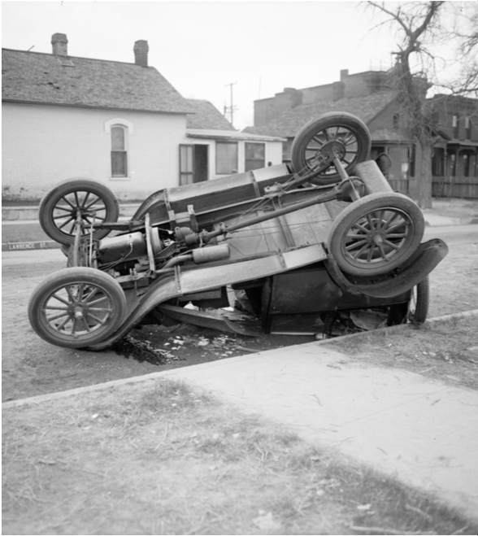
Model of Causation
In September, Charlie drove through an intersection and was killed in a car crash. The police officer investigating the accident noted the night fog and wet, slippery road conditions on the police report. Charlie had left the party at 2:00am in an agitated state and had been drinking some alcohol at the party. Despite this, none of her friends at the party attempted to stop Charlie from getting behind the wheel of her car. Charlie recently dropped out of university and that failure really disappointed Charlie’s fiancée. They had a big fight about it, which resulted in the couple breaking off their engagement.

Slide 21
Model of Causation
Using the handout provided, answer the following questions.
What caused Charlie’s accident? List all the possible causes.
Organize the causes into “underlying,” “short-term,” and “trigger” cause.

Slide 22
Cause and Consequence
Triangle Debate
The class will be divided into three (3) groups. Each group will be assigned one category: Underlying, short-term or trigger cause. Your group will have to argue why your causes are the most important out of all.
You will have 3 minutes to discuss your argument with your group before presenting and debating it with the rest of the class.

Slide 23
Model of Causation
Answer the remaining questions on the handout provided.
c) Rank the causes in order from most important to least important by assigning “percentage responsibility” to each.
d) What are some of the short-term and long-term consequences of the accident?
e) Which consequence is the most important?

Slide 24
THE LEAST YOU NEED TO KNOW…
1) Change is driven by multiple causes and results in multiple consequences.
2) Some causes and consequences are more important than others.
3) In order to fully understand why a historical event happened, we can’t just focus on short-term and trigger causes. Instead, we also need to focus on long-term, underlying causes that may go back years, decades or even centuries in history.

