Slide 1
1.1 The First Peoples

Slide 2
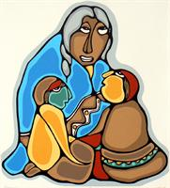
Introduction
Observe the following paintings painted by First Nations artists. What insight do the paintings give you into the lifestyles and values?

Slide 3
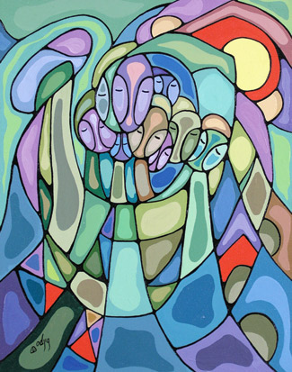
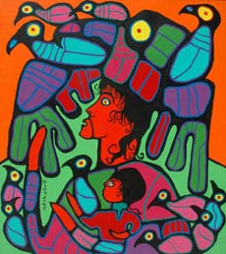

Slide 4
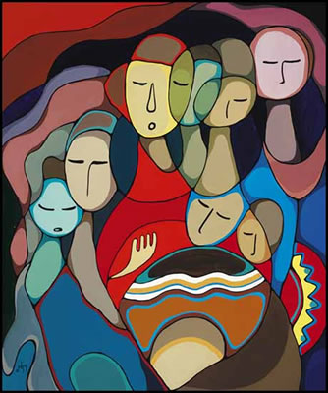
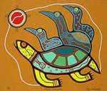

Slide 5
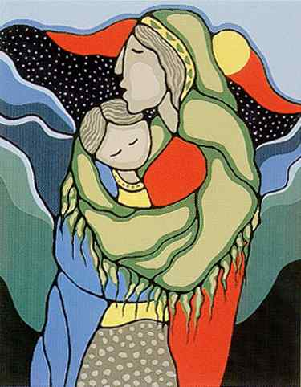
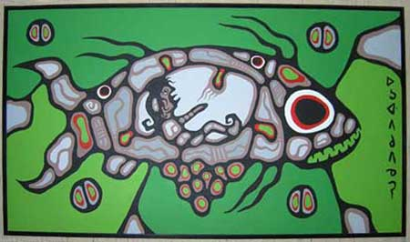

Slide 6
The First Peoples of Canada
The history of the land that is present-day Canada stretches back thousands of years. Science and oral tradition provide us with differing explanations of when and how the First Peoples came to live in what is now called Canada.
The First Peoples formed many self-governing nations and created a wide variety of cultures. An important element of Canada’s history is the story of how the First Peoples related to each other, understood and explained their world, and organized their lives.

Slide 7
The First Peoples were self-governing nations with a wide variety of dynamic cultures. There were 6 major groupings in Canada:
Arctic
Subarctic
Eastern Woodlands
Plains
Plateau
Northwest Coast

Slide 8
These 6 major cultural groups can be divided into 50 different First Nations (once called tribal groupings).
These major cultural groups roughly correspond with the physiographic regions of Canada.

Slide 11
What’s in a Name?
Colombus first used the word Indian to describe the natives of North American, because, when he arrived at the island of Dominica he thought he had reached the East Indies (India).
The world Eskimo, first used by a French priest in the 1600s, means “eaters of raw meat”.
Neither group uses those names for itself.

Slide 12
Aboriginal Names & Their Meanings
Assiniboine: people who use stones to cook
Dene: the people | Inuit: the people
Haida: the people | Iroquois: poisonous snake
Kutchin: the people | Mi’kmaq: allies or friends
Mohawk: man eater | Ottawa: traders
Salish: the people | Naskapi: rude people
Dakota: allies | Beothuk: man or human
What does this tell us about
how the groups think of themselves?

Slide 13
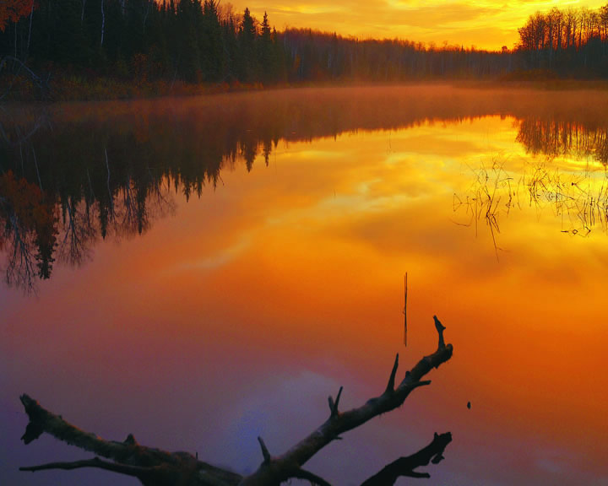
First Nations Theories of Origin
First Peoples’:
  Created in North America by the Creator
  Have always been there
Supported by legends and oral histories

Slide 14
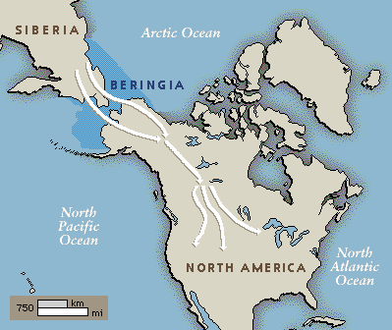
Non-First Nations Theories of Origin
The Land Bridge Theory
  Bering Strait covers a submerged land mass that was above water during the last Ice Age
  People used this land bridge to migrate from Asia to North America, and then through the Americas
  Between 25 000 and 12 000 years ago

Slide 16
Ice Bridge
  Crossed the Bering Strait during the Ice Age when the water was frozen
Canoed from Asia across the Ocean, stopping at various islands along the way

Slide 17
Traditional Worldviews of First Peoples in North America
What is a worldview?
  A worldview is a person’s set of beliefs or assumptions about the world and how it works.
We each look at the world through our own set of “lenses” that affects how we perceive the world, other people, and our experiences.
Every individual has a unique worldview, but people from the same culture and time period tend to have similar worldviews.
Understanding Canada’s history requires some understanding of this country’s First Peoples and their traditional worldviews.

Slide 18
Spirituality
First Nations and Inuit believed:
  Everything has spirit (plants, animals, rocks, rivers, and the sky)
  Find balance and harmony with the environment. For example, hunting communities believed animals participated in hunt by willingly sacrificing themselves to allow people to survive. Most communities took care to use as much of the animal as possible so the animal spirits would not be offended by the waste.
  Find harmony spiritually, mentally, emotionally and physically.

Slide 19
Caretakers of the Land
Give-and-take-relationship
Not a sense of ownership
Well-being of the land = well-being of their communities.
Resources = gifts from the Creator.
Communities with a mobile lifestyle did not wander randomly – they moved seasonally through their people’s traditional territory, taking advantage of each resource (berries, rice, fish, animals, maple syrup, or medicinal plants).

Slide 20
Language
Verb based
Reflects a world full of motion, energy, and change.
Focus on connections and relationships
English and French are noun based language, reflecting a world seen through discrete objects and division, such as living/non-living and black/white.
Focus on differences

Slide 21
Values
Co-operation, autonomy, sharing, and diversity
All members of the community contribute to its well-being, food and other goods should be shared among all.
Shared the most = most admired.
On the West Coast, where resources were fairly plentiful, many First Nations had a formal ceremony for sharing: the potlach
  Potlach means “to give”

Slide 22
Oral Traditions
Share values and ideas of a community’s worldview
Entertain, educate, preserve cultural ideas and traditions.
Stories belong to each community that tell them and often only certain people have the right to tell them.

Slide 23
“The story of life in North America before the arrival of the Europeans can be found in the sporadic archaeological evidence that survives. But it is also passed on to us through the oral tradition of the continent’s first inhabitants. While the archaeological record is more factually reliable, the oral legacy is often more compelling and speaks to a larger, metaphorical truth. These stories teach, record history, and offer entertainment. Unconfined by a conventional western narrative structure, with circular themes and wild, surreal tangents, they often resemble dreams: the collective wisdom and nightmares of a people.”
- Canada: A People’s History, Don Gillmor and Pierre Turgeon

