Slide 1
European Explorers to North America

Slide 2
EXPLORATION
Notes:
-What do you think of when you think of exploration?
-What or where would you choose to explore? Why?
-What would you need to know before you started to explore?
-What might you say to other people to convince them to join an exploration?

Slide 3
Why did explorers come to what is now Canada?
Beginning largely in the 1600s, the French and British began to explore what is now Canada.
These early explorers set out on their voyages for various reasons.
Notes:
-Why do you think Europeans left home to explore new worlds?
-What were they looking for? What were their motivations?
-Would you be interested in joining an expedition to unknown lands? Why?
-What questions would you still want answered before setting out?
-What type of people do you think were attracted to the adventures of exploring new lands?

Slide 4
The Vikings
Lived in Northern Europe (Norway/Denmark)
Explored and settled in Iceland and Greenland
Landed in North America in 1000 A.D.
Sagas tell us information about their voyages

Slide 5
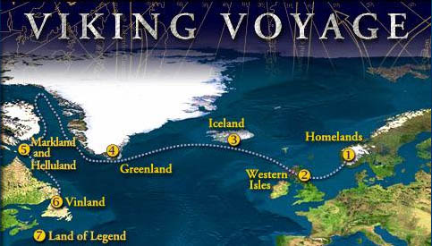
Leif Ericsson discovered Helluland, Markland, and Vinland

Slide 6
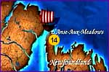
Vikings in North America
In 1960, the L’Anse aux Meadows site was rediscovered
The only authentic Viking settlement in the New World
Many artifacts were discovered at this settlement, including buildings, nails, chunks of iron and charcoal

Slide 7
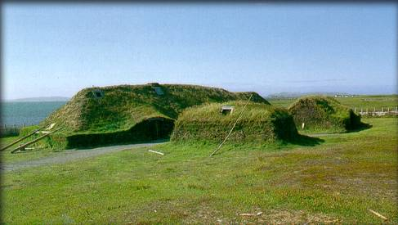
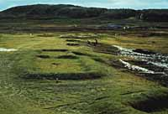
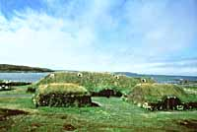
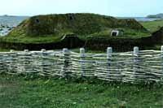
L’anse aux Meadows, Newfoundland

Slide 8
It would be another 500 years, in the 1490s, before any other recorded Europeans explored North America

Slide 9
Renewed Interest in Exploration
In the mid 1450s, overland trade routes connecting Europe with Asia were severed
This occurred when Muslim Turks conquered the city of Constantinople
European monarchs imported a wide variety of goods from Asia including spices, silks, tea, gold & silver
In desperation, they began to finance expeditions to find an western ocean passage from Europe to Asia

Slide 10
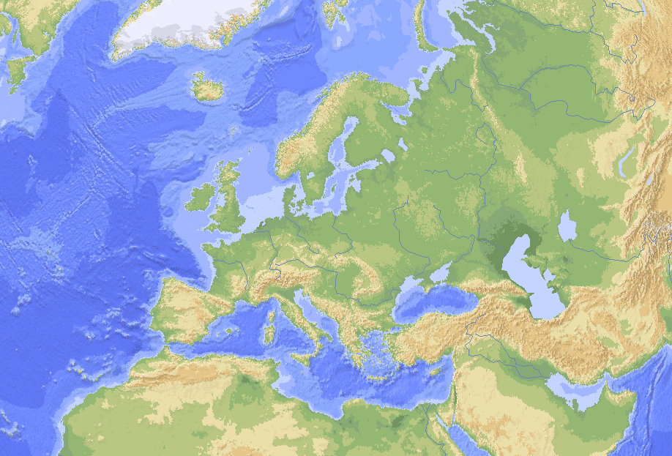
Trade routes from Europe
Trade routes to Asia
European/Asian trade routes were closed in the mid 1400s when Constantinople was conquered

Slide 11
European View on Exploration…
Europeans claimed “discovery” of North America because they believed:
Worldview of superiority
terra nullius meaning “land belonging to no one”.
Land in the Americas belonged to no one so they claimed the land for European countries (it was clear other people were living there)
First Nations were not Christian so land could not belong to them

Slide 12
Europeans seized the land they explored even though First Nations had been living there for thousands of years.

Slide 13
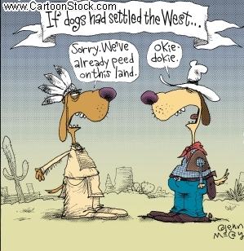

Slide 14
In groups, discuss the following question:
How do you think the arrival of Europeans changed the lives of First Nations people in North America?
Prepare a response to share with the class listing advantages and disadvantages.

Slide 15
As the quest continued…
More and more explorers reached North and South America, realizing the riches of the land
The French and British increased their efforts to explore and settle in North America, and exploit the natural resources that existed there.
Competition increased so permanent settlements were built to deter their European competitors

Slide 16
Permanent Settlements were also established because…
Mercantilism
Belief that a country could accumulate wealth by exporting more goods than it imported
Needed steady supply of raw materials to make goods
Colonialism
The control and exploitation of a territory through settlement
Claiming and occupying new land increased power
Religion
Desire to spread Christianity to First Peoples
“Help” First Peoples and benefit cultures

Slide 17
“Our explorers are to…seek out, discover and find whatever isles, countries, regions or provinces of the heathen and infidels…[that] before this time have been unknown to all Christians.”
-King Henry VII of England

Slide 18
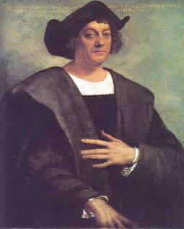
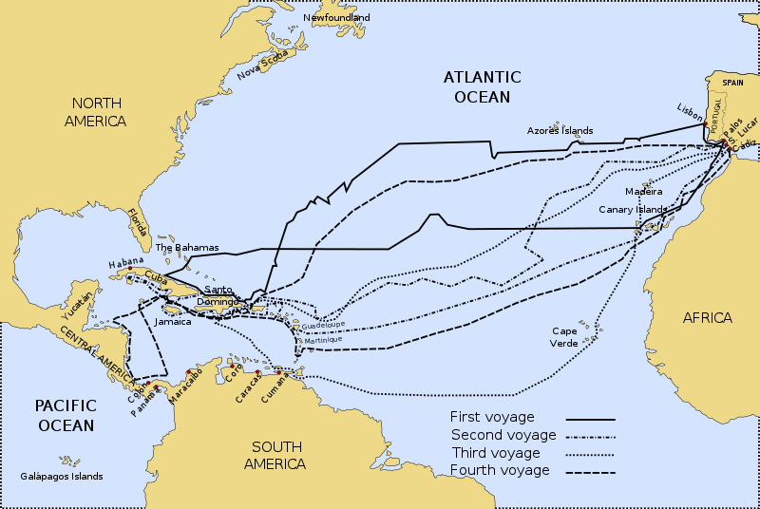
Christopher Columbus
Columbus wanted to reach India and the Far East by travelling westward from Europe
Sailed for the King of Spain, he discovered land in 1492

Slide 19
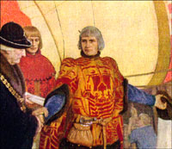
John Cabot
An Italian explorer, wanted to find a new route to the Far East
Cabot first sailed to Newfoundland in June 1497
He claimed the land for England and returned telling people that he had reached Asia
Instead of reporting spices,
Cabot told of huge schools of fish in the coastal waters

Slide 20
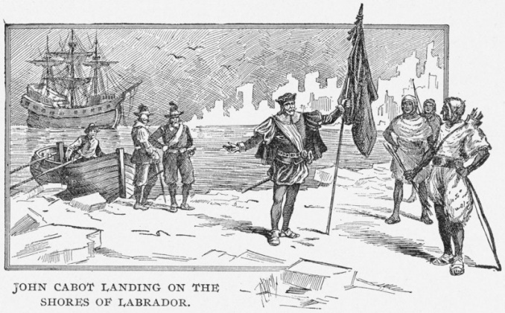

Slide 21
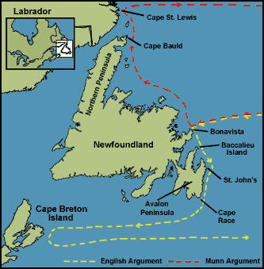
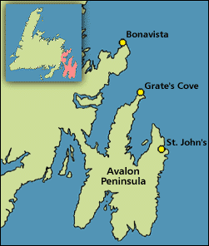

Slide 22
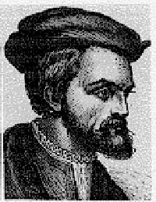
Jacques Cartier
Sailing from France, he travelled west
to find gold in the New World and to
find a passage to the Far East
Made three voyages to the New World between 1534-1542
On his first voyage, Cartier explored the coastline of both north-east and western Newfoundland
He also explored the Gulf of St Lawrence region and made contact with the Iroquois

Slide 23
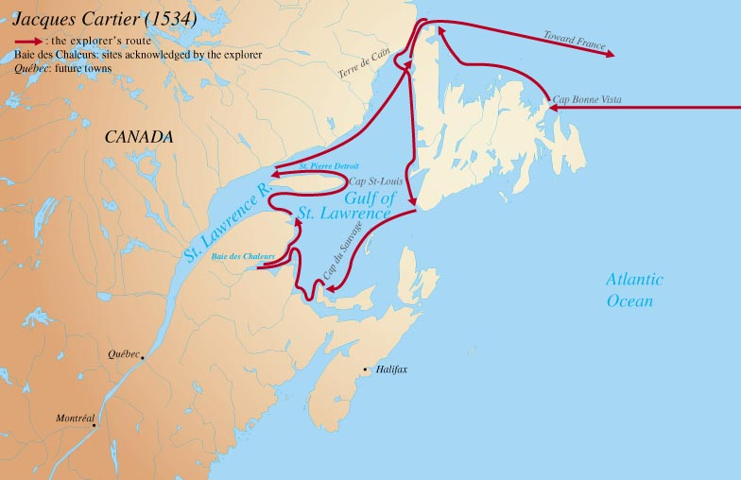

Slide 24
On his second voyage in 1535, Cartier explored the St Lawrence River and the areas around present day Montreal (Hochelaga) and Quebec City (Stadacona)
Cartier spent the winter in this region and lost many of his men from scurvy due to a lack of fruits and vegetables
He also made contact with local Natives on this journey
It is believed the name Canada came from a meeting with Natives on this second voyage

Slide 25
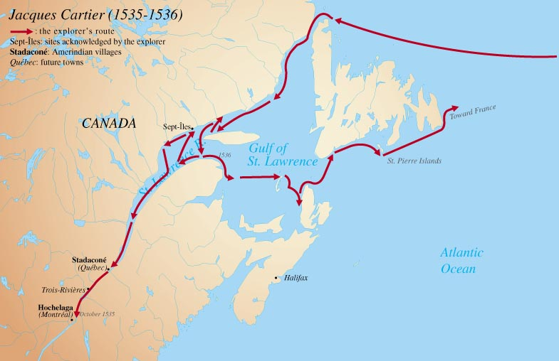

Slide 26
A third voyage occurred in 1541 with five ships and 1500 people
The main purpose of this trip was to set up a colony for France
They spent the winter in Stadacona and Hochelaga but returned to France in 1543
Their return ended France’s first attempted settlement in the New World

Slide 27
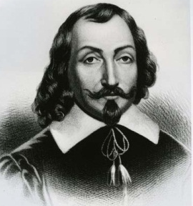
Samuel de Champlain
Often referred to as the “Father of New France”
After decades of war, France needed new resources and thought wealth could be found in North America, especially beaver pelts
King founded a company whose goal was to create a colony in North America and trade fur

Slide 28
Samuel de Champlain
Champlain and the head of the company set sail in 1604
Established a few colonies before setting sights on old Stadacona village in 1607 (abandoned due to environment, warfare or disease)
Advantageous for trade and fertile ground
Named new colony Québec, taken from word Kébec meaning “where the river narrows”.

Slide 29
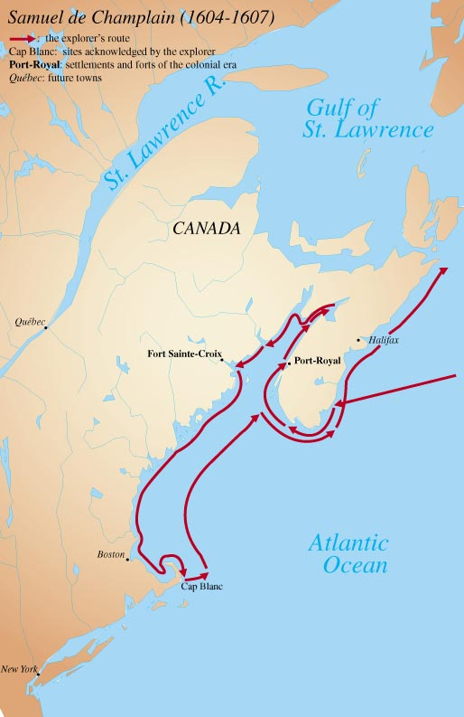

Slide 30
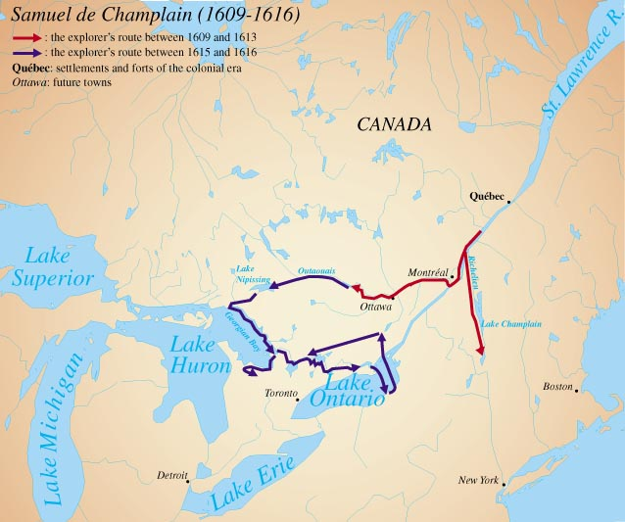

Slide 31
In 1608 Samuel de Champlain established the first settlement at Quebec

Slide 32
Samuel de Champlain
From this point onward most immigration to the area came from France until 1763 when the British defeated the French and drove those interests from North American soil.

Slide 33
Abitation de Quebecq…
Means The Habitation of Québec
“Habitants” refers to early French Settlers
So why do you think the Montreal Canadians are referred to as the “Habs”?

Slide 34
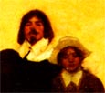
Interesting Fact…
When Champlain was 42, he married 12-year old Hélène Boullé
Arranged married
Dowry of $13, 000

Slide 35
Henry Hudson
In 1610, sailed into a straight and went southward thinking it was the Northwest Passage
Turned out to be an inland sea (aka – Hudson Bay)

Slide 37
