Slide 1
Life in Nouvelle-France
1608-1763

Slide 2
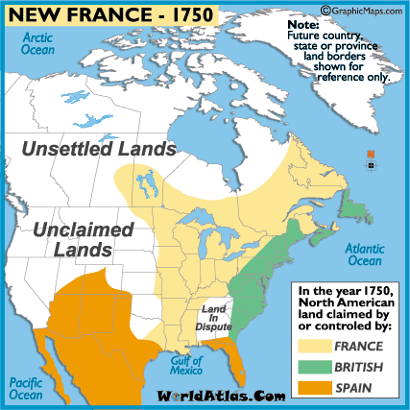

Slide 3
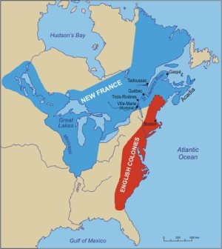

Slide 4
Early Life in Quebec
Climate was severe
“The Great River,” or the St. Lawrence never lead to the East as Cartier hoped
France abandoned colonization for 65 years.
In the summer France came to Newfoundland to fish and then trading began with the First Nations.
The fish and furs forced France back to the New World.

Slide 5
Geography of Nouvelle-France
Population was very small
By 1740, the territory of New France went all the way to the Gulf of Mexico ( La Salle and Cavelier)
This Southern region was called Louisana

Slide 6
Economy of Nouvelle-France
New France was a colony which meant it was not an independent entity.
It belonged to the mother country
A colony’s main job is to support the mother country and provided it with riches.
Two main goals:
  Fur trade provided new raw materials
  Provide useful markets for goods produced in the mother country (cloth, hardware, etc)

Slide 7
What is mercantilism?
New France provided France with the raw materials and then sent them to France where they became manufactured goods. France then sold the manufactured goods back to the colony.
  This system made the colonies a profitable economic enterprise.
Advantage:
Produced wealth and consumed goods for the mother country
Disadvantage:
The development of the colony was always in the interest of the mother country and not the colony.
Trade with other places was forbidden

Slide 9
Immigration to New France
Champlain established the colony in 1608, and French immigration ended in 1759 when the English conquered New France.

Slide 10
Indentured Servants
Who are they?
Men who came to New France to work for a certain amount of years (3-5) under a contract from France.
Most of these men were criminals, poor, unmarried, or unemployable in France.
What they received:
Freedom: many go back to Europe
They were promised food, a small salary (half of which was saved for them until after their term of employment,) passage back to France.
Drawbacks:
These men could not marry, trade for themselves, or farm.
Notes:
They were nicknamed the “36-month men” because of the typical length of their colonial contract.

Slide 12
Jesuits
Just as it did in France, the Roman-Catholic church played an important role in the colony.
The first and foremost role was to provide religious services for the colony and to try to convert the First Nations people.
From as early as 1625, the Society of Jesus (the Jesuits), worked in New France with the primary goal of converting people to their faith, as a service to mankind.
  However, they also taught the applied sciences, philosophy, agriculture, commerce, and mechanics, as well as offering medical services.
They decided to live among the First Nations people, learning their language and culture.
  Converts often came into conflict with those who followed the traditional ways of their people.
  In addition, Catholic converts were given guns by the French; non-Catholics were not…

Slide 13
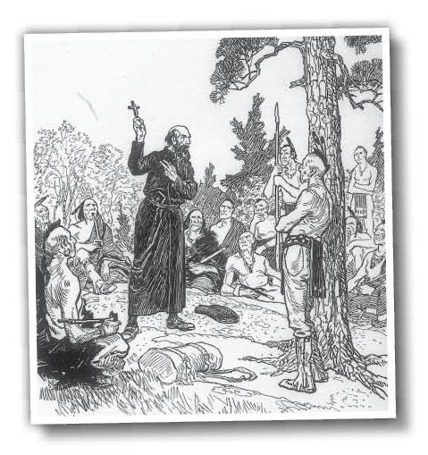

Slide 14
We know the story of the first Jesuits in Canada because they were methodical in keeping journals.

Slide 15
The Ursulines
The Ursuline nuns arrived in New France in 1639, and mangaged the first European schools and hospitals.
  In 1645, Jeanne Mance, a missionary, established Hôtel-Dieu, the first French hospital in Montreal.
With the help of the Church, the colonists were generally better cared for than the citizens back home in France.

Slide 16
Marie de l’Incarnation was the first Mother Superior of the Ursuline convent of New France

Slide 17
…they have kinds of prophets or seers who take it upon themselves to say what will happen in the future. But, in fact, they are sorcerers and magicians who apparently have commerce with Demons. They use little drums, songs and whistles to cure illnesses. They have little tabernacles to consult spirits of the air and make use of pyromancy to find out how diseases will progress, which places will be good for hunting, or whether there is some enemy hidden in their lands, and for other similar occasions.
—Marie de l’Incarnation, Correspondance.

Slide 18
Others [Savage girls] are here only as birds of passage and remain with us only until they are sad, a thing the Savage nature cannot suffer; the moment they become sad, their parents take them lest they die.
—Marie de l’Incarnation, Correspondances,
to her son, Québec, August 9, 1668

Slide 19
Filles du Roi
In 1663, there were fewer than 3000 people living in New France.
  There was only one woman for every six men in the colony. This meant that there were few opportunities for the men to marry and start families.
  France was also concerned because the population numbered only around 3000 people. By comparison, the British colonies along the east coast of North America had reached almost 100 000 people by 1663. Eager to see Nouvelle-France grow, Jean Talon and the government of King Louis XIV devised a plan to address the gender imbalance.
Notes:
-What policies were introduced to encourage immigration? To increase the birth rate?

Slide 21
Eager to see the colony grow, Jean Talon and the government of King Louis XIV devised a plan to address the gender imbalance.
From 1663 to 1673, the government searched for single and widowed women in France to send across the ocean to the French colony.
It was expected that upon arrival, the women would marry one of the Frenchmen in the colony, raise a family, and become a permanent colonist.
  As an incentive to make the journey and change in lifestyle, the government awarded many girls with a dowry of 50 French francs, and provided all the necessary travel expenses.
  Because the king paid for all this, the women became known as les filles du roi—the king's daughters.
Most were orphans from state orphanages or women with no family support or resources.
Notes:
French recruiters often found potential fl/les du roiin orphanages. Fifty francs was a large sum of money at this time (for example, .a surgeon may have had to work one year to earn 100 francs), so many young women saw the king's offer as an opportunity to leave their poor circumstances behind.

Slide 22
Upon arriving in Nouvelle-France, the young women had to learn about a new and different country.
It was expected that they would find a husband within a few months of arrival.
  To promote a natural population increase, money (a baby bonus) was offered to families with over ten children.
  In addition to having babies, these women were expected to help with the farming chores—not an easy task in early Nouvelle-France.

Slide 23
The French government's plan with les Filles du Roi worked. In 1671, there were over 700 births in Nouvelle France.
Many French Canadians today can trace their lineage back to one of les Filles du Roi.

Slide 24
“All volunteer companions and others of marriageable age are enjoined to marry two weeks after the arrival of the ships bearing the filles or else be deprived of all liberty to hunt, fish and trade with the Indians.”
By Order of Jean Talon, October, 1671

Slide 25
“[I]n compensation for a multiplicity of children and for bringing them into marriage, His Majesty ... hereby orders that, in future, all inhabitants of the country who have up to ten living children... will be paid ... a pension of 300 livres each, and those with 12, 400 livres ... .
Moreover, His Majesty desires that ... all boys who marry at 20 years and under, and girls at 16 and under, be paid 20 livres for each to celebrate their nuptials, which payment shall be called “the king’s present”.
Declaration of the King’s State Council, 1670

Slide 26
“The girls sent last year are married and almost all are pregnant or have had children, marking the fecundity of this country.”
Letter from Jean Talon to the French court, 1670

Slide 27
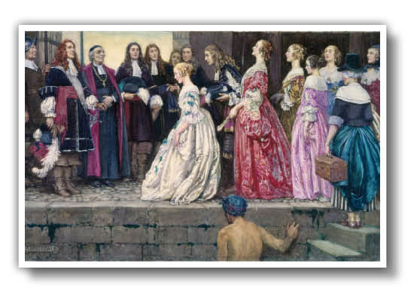
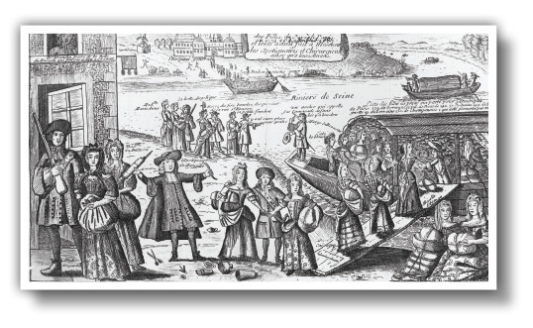

Slide 28
Ethical Dimensions
In looking at these images of les Filles du Roi, do you feel they accurately portray the experiences these young women went through? Do you believe that the decision to send young women to North America for purposes of population growth was ethically sound?
Explain your answer.

Slide 29
Consider the Ethical Dimensions
What are the arguments for why the Filles du Roi might have been considered ethical or not
Arguments For | Arguments Against

Slide 30
Fur Trade
Fur trade: main economic trade of New France.
It is often said that a rodent, not people, built Nouvelle-France.
Furs only important export of colony
Quest for furs forced France further into the continent causing alliances with First Nation Groups and competition with other European countries.
The demand for fur altered the course of history for everyone involved.

Slide 31
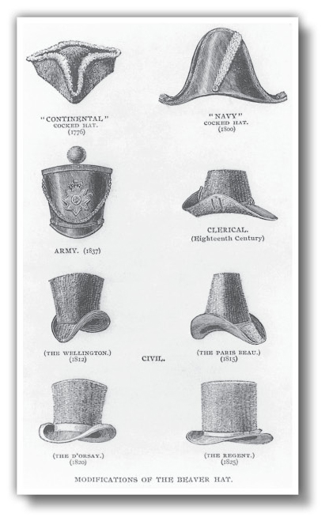
These different styles of beaver hats were in such demand in Europe that they helped fuel the fur trade in North America.

Slide 33
Cause & Consequence
If there had not been a fashion demand for beaver pelts in Europe, how do you thin this would have affected colonization efforts in Nouvelle-France?

Slide 34
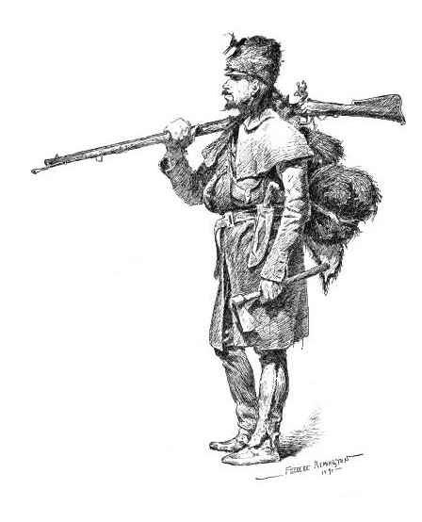
Coureurs de Bois
They left their farms in the summer and meet
the Aboriginal trappers at their hunting grounds.
They were responsible for transporting the furs
from the interior to the colony
Two Main Purposes
Economic: increase revenue to support the growth of France and to support the constant wars against Britain
Military: with the help of the Aboriginals, each country could expand further westward and defeat the other country

Slide 35
Coureurs de Bois
Advantages
The furs they produced enriched the colony
Help secure loyalty with Aboriginals
Adventured further inland.
Disadvantages
Authorities did not like them neglecting their farms
They lead a footloose life.
Officials could not enforce laws against them as they could slip into the wilderness
Independent traders working for own profit not colony.

Slide 36
First Nations-European Contact
Champlain once said: “I promised to help them in their wars, both to engage them more to love us, and also to help my enterprises and exploration, which could only be carried out with their help.”

Slide 37
Creating Alliances
Benefits for the First Nations | Drawbacks for the First Nations
Benefits for the Europeans | Drawbacks for the Europeans
What are the effects of making contact?

Slide 38
British-French Hostilities
While Nouvelle-France struggled to grow into a sustainable colony, other forces were at work that directed its future.
  During the 18th century, Britain and France began to intensify their fight for land and power in North America.

Slide 39
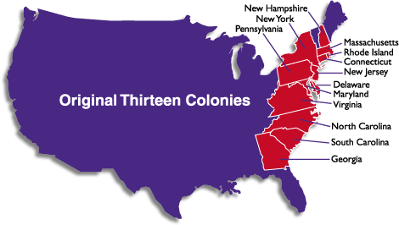
13 Colonies
Arrived in 1607
Jamestown on Chesapeake Bay
Instead of fur trade, their economy relies heavily on tobacco

Slide 40
Population: 13 colonies vs. Nouvelle-France
Year New France 13 Colonies
1660 3 000 90 000
1710 18 000 331 711
1720 24 474 446 185
1750 53 000 1 170 760
1760 64 041 1 593 625
Why did Nouvelle-France not grow as fast as
the 13 Colonies?

Slide 41
Different Landscapes
The population of New France was restricted to the relatively small area around the St. Lawrence River because that was where the limited area of fertile land existed
Milder Climate
The British settlements in the 13 Colonies were farther south and it was far more attractive and easier to live in a warmer climate than the harsh realities of winter in Nouvelle-France

Slide 42
Importance of the Fur Trade
New France was so reliant on the fur trade as their economic basis that they didn’t need as many people to operate the fur trade as the much more diverse and mixed economy of the 13 Colonies (furs, fish, wheat, timber)
Nouvelle-France tied to Mercanalism
New France was discouraged from developing their own trade, instead being required to send everything to France.
The 13 Colonies produced a variety of products and crops and were allowed to carry on substantial trade with the rest of Europe, not just Britain.

Slide 43
Immigration Restrictions
New France only allowed French Catholics to enter and settle.
The 13 Colonies were much more open to immigration that included the Dutch, German, Scandinavians, as well as French-Protestants.

Slide 44
