Slide 1
Northwest Changes
Cluster 2

Slide 2
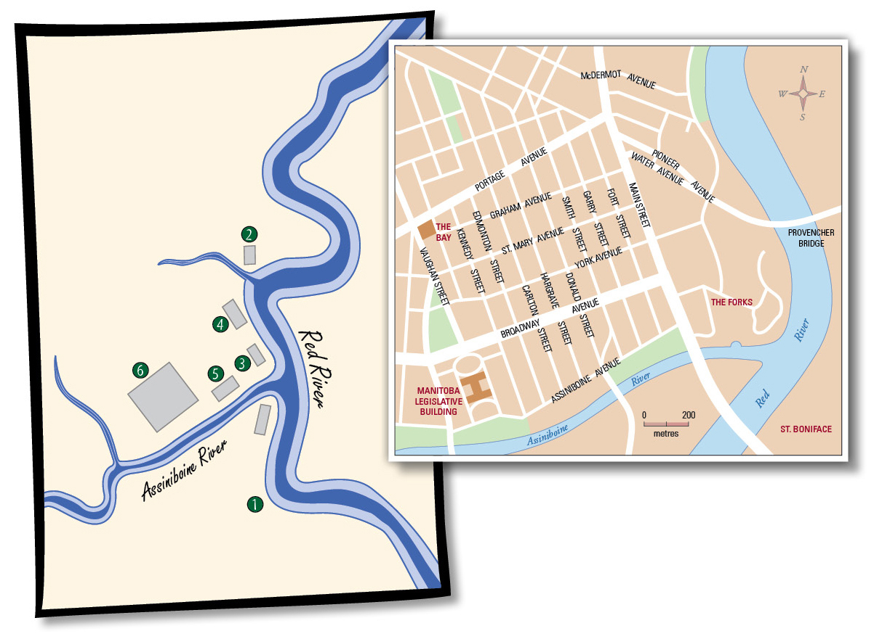
Notes:
1-Fort Rouge
2-Fort Douglas
3-Fort Gibraltar
4-Fidler’s Fort (now Pioneer @ McDermot)
5-(Upper) Fort Garry-destroyed by flood in 1826
6-(Upper) Fort Garry-rebuilt in 1835

Slide 3

Hudson’s Bay Company
Formed in 1670
Operated in Rupert’s Land…all the land that was drained by rivers flowing into Hudson’s Bay
London-based
Coastal trading posts located at the mouths of major rivers
Natives would trap furs & bring them to the coastal posts

Slide 4
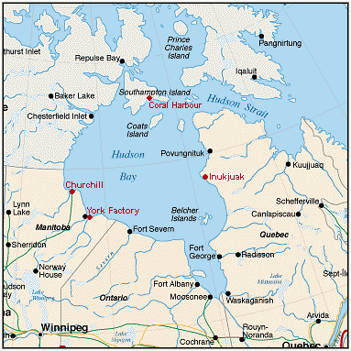
HBC…Advantages
Close to fur supplies in northern Canada
Ships could enter the center of the continent via Hudson’s Bay
Costs were low…no inland traders

Slide 5
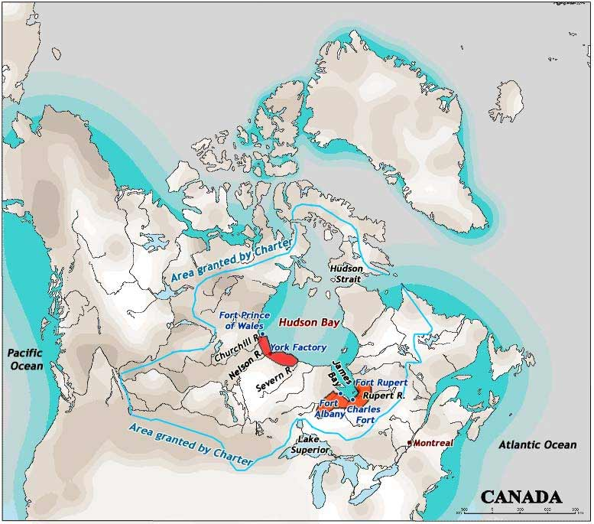

Slide 6
Their monopoly would not last forever…

Slide 7
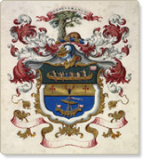
North West Company
Formed in 1779
Montreal merchants / Independent traders
Montreal-based
Nor’Westers supervised trade in the west
Other were responsible for exporting furs from Montreal
French-Canadien Voyageurs paddled canoes

Slide 8
NWC
Nor’Westers moved into western Canada in search for furs
Alexander MacKenzie, Simon Fraser, David Thompson explored much of western Canada
NWC trade extended into the Rocky Mountains

Slide 9
NWC….PROBLEMS
Distance (Montreal to Western Canada)
Two-way transportation system emerged
  Montreal to Fort William (Thunder Bay)
  Fort William to the West

Slide 10
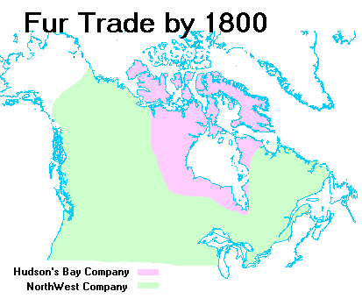

Slide 11
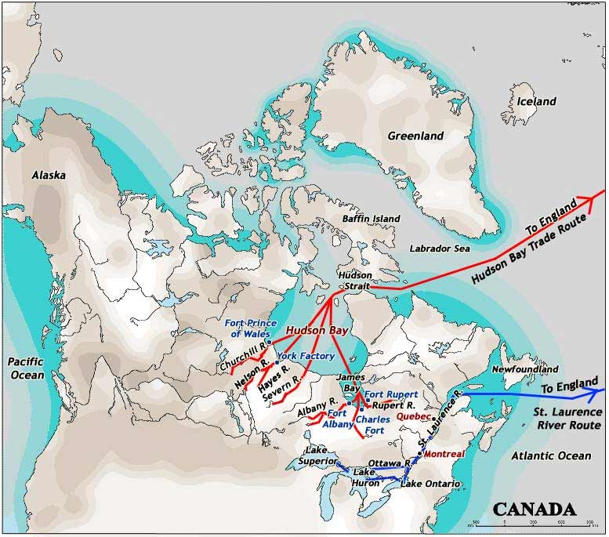

Slide 12
The fur trade grew to be one of the most important industries in North America.
The demand for fur in Europe encouraged further exploration of North America in the search for new sources of fur.
The quest for fur pushed the coureurs de bois and the men of the Hudson’s Bay Company west.
Rivalries drove the HBC-based traders to compete with other traders, eventually uniting these other traders to create the North West Company

Slide 13
How do you explain the differences and similarities of the two systems?
Based on your knowledge of the companies’ trading systems, why do you think they merged in 1821?

Slide 14
Rivalries between the HBC and the NWC
The NWC wanted Britain to put an end to the monopoly the HBC held over fur trade in Rupert’s Land.
The British government refused the request and the rivalry intensified.
The NWC’s success depended on constantly moving farther west and tapping into new territories for fur.
Unlike the Baymen (employees of HBC, living on the shores of Hudson Bay), the Nor’Westers were always on the move, pushing farther west.

Slide 15
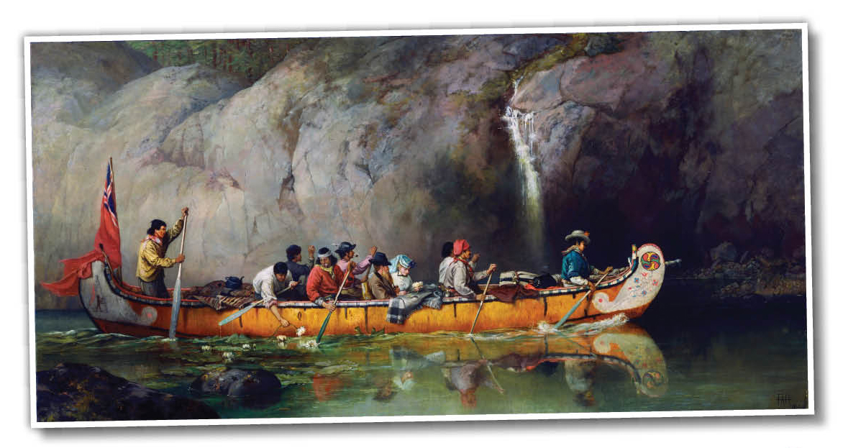
One advantage of NWC was its partnership with the voyageurs.
Voyagers developed a unique culture defined by their life in a canoe, the geography of the fur trade, their French language, their style of dress, their close relationship with the First Nations people, and their songs, which they sang to break the monotony of padding.
Notes:
The voyageurs lived a life of endless paddling and difficult portages. They put in 14 hour days, had to carry two 40kg bundles of fur at a time over portages, and rested only once per hour.

Slide 16
As the rivalry progressed, it got out of hand, and at times, violent.
The companies also competed to set better trade rates, which benefited First Nations traders, who could trade fewer and lower-quality furs for more goods.
Notes:
Destroying each others boats and forts.
They attempted to bribe the other company’s FN traders.

Slide 17
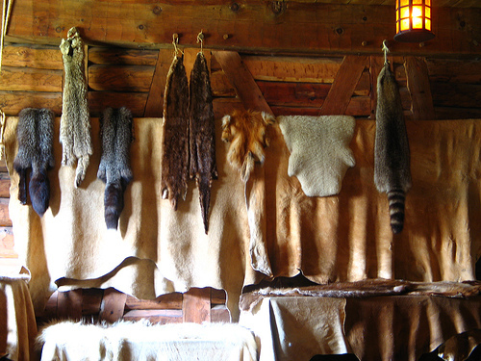

Slide 18
The Métis at Red River
The Métis culture was a result of the French fur trade.
It was the Métis of Red River, however, who grew to have a culture that was representative of their mixed ancestral background.
At Red River, a new culture began to take form.
  A unique language called Mischif evolved as the Métis Nation grew.
  Métis culture was also reflected in music and dance.
  Métis women played a critical role in the development of the Métis Nation and fur trade.

Slide 19
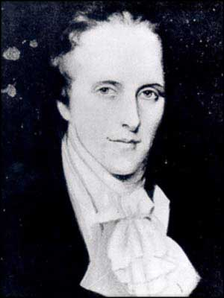
Selkirk Settlers
Thomas Douglas (aka. Lord Selkirk) wanted to establish a farming colony in the Canadian west
He attempted to resettle displaced Scottish farmers in the Red River Colony in 1812
Purchased stock in the HBC & bought land he called Assiniboia in southern Manitoba
Clip: Origins of the Selkirk Settlement

Slide 20
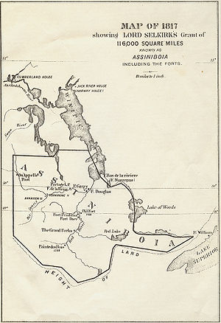

Slide 21
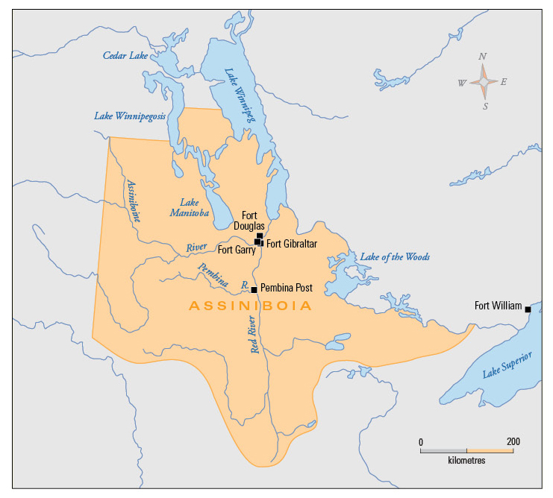
Notes:
Selkirk purchased this land in the Red River area and named it Assiniboia. His goal was to create a colony with immigrant farmers from Scotland and Ireland.

Slide 22
Emerging Problems
NWC operated Fort Gibraltar at the Forks
Suspicious of the HBC settlement
NWC trade routes would be threatened
Food supply & buffalo depletion would starve NWC traders

Slide 23
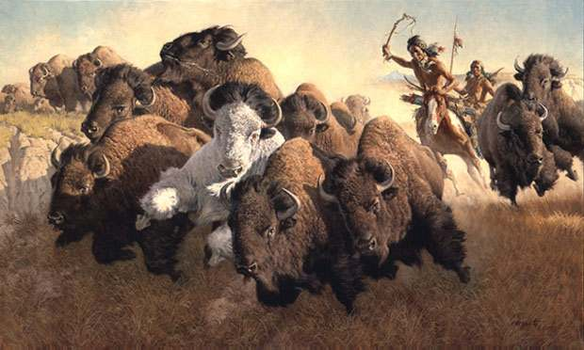
Emerging Problems
Initially, Selkirk settlers had to rely on local food sources…..Buffalo
Acquired their food from NWC trading posts
To ensure enough food for the settlers the Pemmican Proclamation was issued in 1814
Banned the export of pemmican from the colony

Slide 24
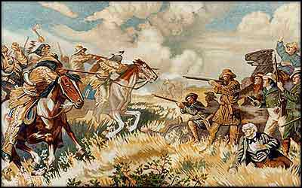
Emerging Problems
Metis & Nor’Westerners in the area were determined to destroy the settlement that threatened their way of life
The Battle of Seven Oaks in the summer of 1816

Slide 25
The Pemmican Proclamation
By 1810, the Métis had established themselves as the main providers of pemmican and other bison products to the NWC at Red river, however, Lord Selkirk’s colony of immigrants were having a difficult time.
The Métis viewed the Selkirk colonists as a threat to their place in the fur trade and an infringement upon their territory and main livelihood.
Notes:
As crops failed or did not mature in time, the Selkirk settlers experienced food shortages and began to hunt bison for food.

Slide 26
In response to famine conditions, on January 8, 1814, the governor of the colony, Miles Macdonell, issued what is known as the Pemmican Proclamation, which banned the export of food from Red River.
The proclamation was meant to ensure that there would be adequate provisions for the immigrants in the colony.
The groups most affected were the Métis and NWC traders. Because the Métis relied on the pemmican trade as a part of their economy, the ban caused hardships in the community.
It also prevented the NWC from supplying its trading posts with pemmican, an essential food source.

Slide 27
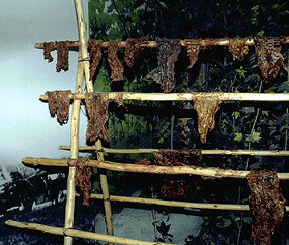

Slide 28
What ensued became known as the Pemmican War. It began when men from the HBC began searching and seizing pemmican from NWC forts.
The Nor’Westers retaliated by arresting and imprisoning the HBC men for burglary.
The Nor’Westers also destryoyed the crops and razed the buildings established by the Selkirk immigrants near Fort Douglas.
Skirmishes continued for the next few years. Macdonell resigned as governor and was replaced by Robert Semple, an American businessman with no previous experience in the fur trade.
Notes:
Fort Douglas: just down river from Fort Gibraltar
The Métis and Nor’Westers were determined to drive the Selkirk immigrants from the colony.
In the summer of 1815, there was only 3 immigrants left.

Slide 29
The Battle of Seven Oaks
In the spring of 1816, the new governor, Robert Semple, gave the command for the HBC to capture and burn Fort Gibraltar, a NWC fort near Fort Douglas.
Cuthbert Grant, the son of a Métis mother and Scottish father, was a Métis leader and spokesperson. On June 19, 1816, Grant and a party of about 60 men were making their way along the Assiniboine River.
Semple had blockaded the river with boats, so Grant and his party left the river before the blockade and proceeded north by land.
Notes:
To the Métis and Nor’Westers, the burning of a fort was the same as declaring war.

Slide 30
Grant and his men reached an area near Fort Douglas in a cluster of trees known locally as Seven Oaks.
  Waiting for them were Semple and about 27 HBC men and colonists.
After an exchange of words, a gunfight broke out. Within 15 minutes, Semple and 20 of his men were killed, and the Métis lost only 1 man.
Grant sent one of the HBC survivors to Fort Douglas to demand the surrender of the fort.
The colony gave up immediately.
The Battle of Seven Oaks highlighted the fierce struggle between HBC and NWC for control of the fur trade.

Slide 31
Map of
Seven
Oaks
Incident
June 19,
1816

Slide 32
After Seven Oaks
In retaliation, Selkirk and his men captured Fort William, the heart of the NWC’s fur empire in the Northwest.
Selkirk remained at Fort William but sent his men ahead to retake Fort Douglas.
On the way, Selkirk’s troops captured several other NWC posts.
Infuriated by the capture of Fort William, NWC seized 5 small HBC posts in the Athabasca territory.
The war between the companies continued like this for 5 years.
Notes:
Fort William: near present-day Thunder Bay
Athabasca: northern Alberta

Slide 33
The HBC and NWC were in conflict from the time the NWC was founded.
The HBC, though smaller, had the benefit of a royal charter to trade. The NWC had the advantage of larger numbers, and adventuresome employees who helped expand their territory.
By 1820, the HBC pushed farter inland and lowered its trading rates with the First Nations, and put the NWC into a difficult position as they began losing money.
Pressured by the British government, the NWC merged with the HBC in 1821.

Slide 34
Toward the Pacific Coast
By the 19th century, the HBC began to expand west by establishing more outposts to support its trappers and traders.
Interest in different opportunities in the West began to change by the mid-19th century. An influx of immigrants to Upper Canada had taken the best farmland available and people began to look west for new areas to live.

Slide 35
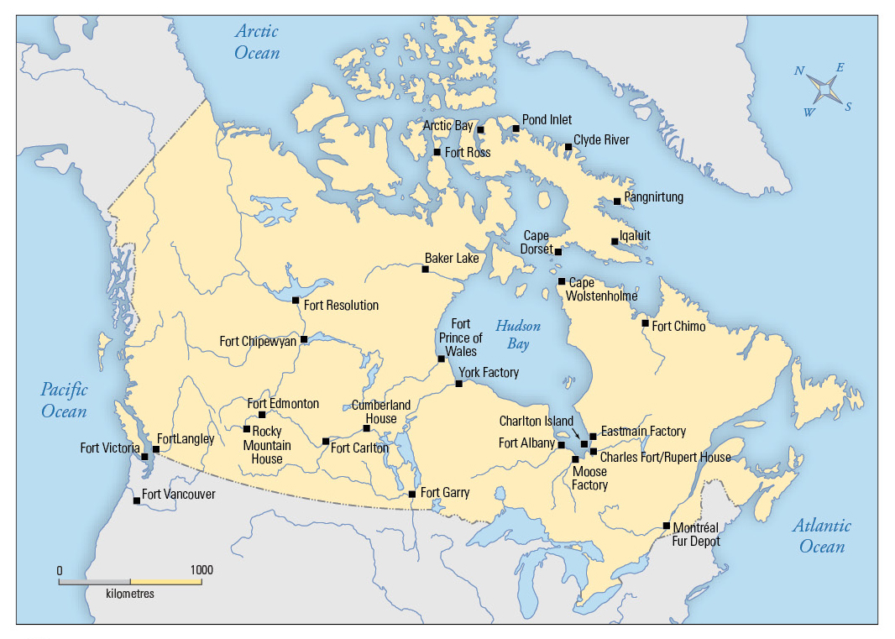
Notes:
Major HBC Forts & Posts in Canada ~1914
By the early years of the 20th century, the HBC had trading posts across Canada

