Slide 1
Citing Your Sources aka…Cite Like a pro!

Slide 2
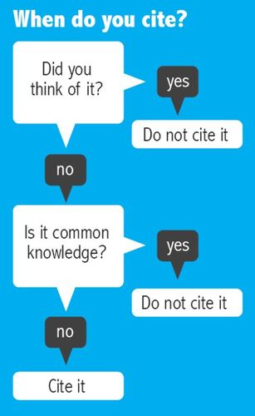

Slide 3
When to Cite
Give credit whenever you use:
another person's idea, opinion, or theory.
any facts, statistics, graphs, drawings-any pieces of information-that are not common knowledge.
quotations of another person's actual spoken or written words.
paraphrases of another person's spoken or written words.

Slide 7
OWL Purdue: The Best Site Ever

Slide 8
An Awesome Example
Martin, K. “Ms Martin is Awesome.” Martin History 30. msmartinhistory30.weebly.com. Accessed September 18, 2017.

