Slide 1
Final Project: Photo Essay

Slide 2
What is your task with a photo essay
Your challenge is to go in-depth into a topic we’ve covered in cluster 3. Your topic can be about a person, historical moment, or historical theme
You will decide on a topic and create a research question to guide your learning
Example: What was the role of animals in the Canadian Corps during the Great War?
Using this question, you will research, and analyze, and compile a photo essay that can be used to teach your audience about your subject.

Slide 3
Some Guidelines
Can be on PowerPoint, Prezi, Movie Maker
Must have 15 full picture slides (picture with text), along with an introduction and conclusion slide, followed by a works cited slide
Each slide should have about 3-4 sentences of information
Works cited in MLA format, works can be cited from the same website
More info on project handout
If you use a source for information and not pictures, you can source that without an image number.

Slide 4
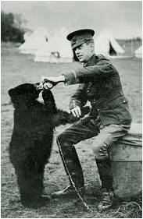
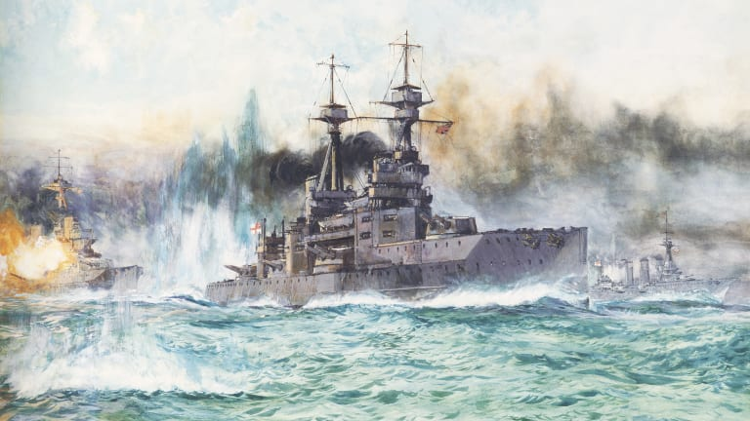
Starting out: deciding on a topic
Choose a topic that is interesting to you but also that you have enough research material to answer.
Open-ended
A good research topic idea:
What was life like in the Trenches during the First World War?
Was Louis Riel’s movement a rebellion or a resistance?
A poor research topic idea:
Why did Canada use pigeons during the First World War?
What was Canada’s role in the Battle of Jutland in 1917?

Slide 5
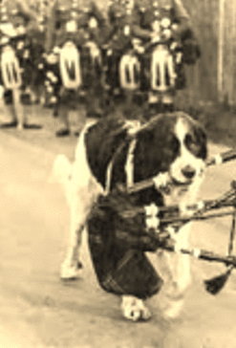
Developing a thesis
Thesis: The main idea and argument behind your essay. This is the main takeaway of your photo essay and what you centre your research on.
Example:
What was the role of animals in the Canadian Corps during the Great War?
Turns Into
The role of animals was essential, not only for battlefield operations but also, for being mascots of military regiments and boosted the morale for the troops in the dingy conditions of the Great War.

Slide 6
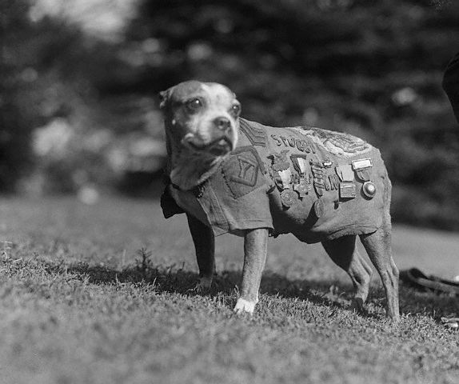
Research: the what and how
Finding the right photo source is going to make your photo essay stand out.
You want to find images that tell a story, while also allowing you to give more information.
Sergeant Stubby
Even puppies can be heroes. Sergeant Stubby entered combat in February of 1918 with the American 102nd Infantry. Stubby was wounded twice by German hand grenades, but each time returned to fight with his men. Stubby made a name for himself by warning about gas attacks, locating wounded men in no mans land, and alerted his comrades on incoming shellfire- which he could hear with his acute hearing. Sergeant Stubby returned home but later died in 1925. He was an honoured soldier, and the bestest of boys.
Knapp. “Animals in War.” Photograph. Canada’s Great War Album, https://greatwaralbum.ca/Great-War-Album/About-the-Great-War/Animals-in-war Retrieved: December 09, 2019.
Canadian War Museum. “Mascots and Pets.” Canada’s Great War Album. https://www.warmuseum.ca/firstworldwar/history/life-at-the-front/trench-culture/mascots-and-pets/. Retireved: December 09, 2019.
Sergeant Stubby

Slide 7
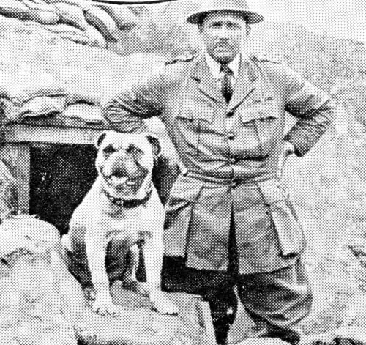
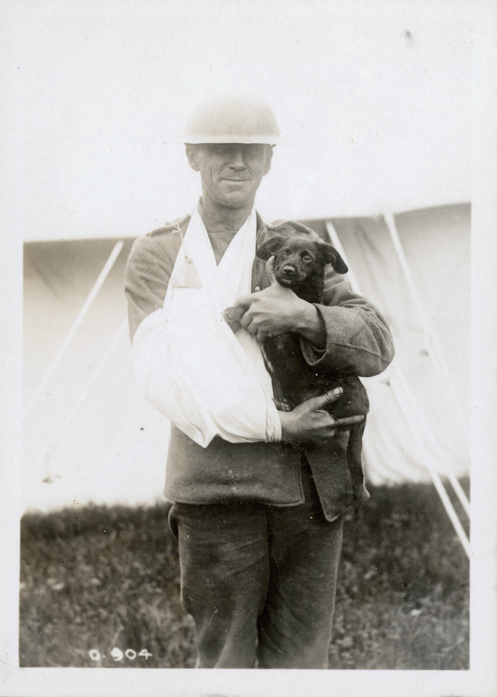
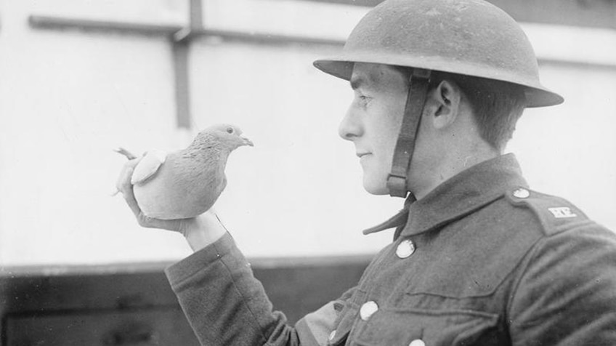
A Soldiers Best Friend: Animals role during the Great war
Mr. Kobewka

Slide 8
Thesis Statement
The role of animals was essential in the Great War, not only for battlefield operations but also, for being mascots of military regiments and boosted the morale for the troops in the dingy conditions of the trenches. Not only were they essential for bringing supplies to the front lines, but many animals held direct military support roles from the war beginning until its end. From horses to pigeons, and from dogs to cats, all played their role in the great struggle, and many gave their lives in the line of duty.

Slide 9
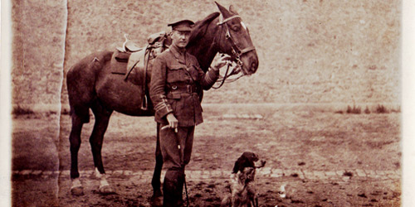
Horses have been used since Ancient times in combat roles. During the Great War, however, horses were an essential form of transportation for soldiers, if they could pay the high costs on owning one. Pictured here is John McCrae, author of Flanders Field, with his horse Bonfire and dog Beanneu.

Slide 10
Horses in the fight
As the war progressed, gas attacks became a constant threat to both soldiers and animals. Gas masks were developed to protect horses from gas attacks, but the chemicals would still cause burns to their skin. Pictured here is a Canadian soldier in the Veterinary Corps, demonstrating his equipment.

Slide 11
Battlefield mascots
As the war dragged on, pets became a common sight in Canadian trenches. Small dogs and cats were most common, and having a pet around would help cope with the harsh conditions of trench warfare. Pictured here is Gibby, a Canadian Mascot who survived multiple gas attacks.

Slide 12
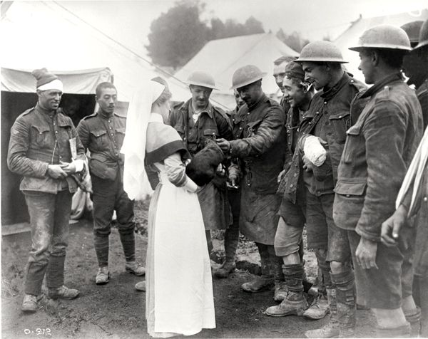
Man’s best Friend
Soldiers suffering wounds from the battlefield could find a friendly face at the local hospital. Hospitals would take in stray dogs and puppy litters to comfort injured soldiers during their recovery.

Slide 13
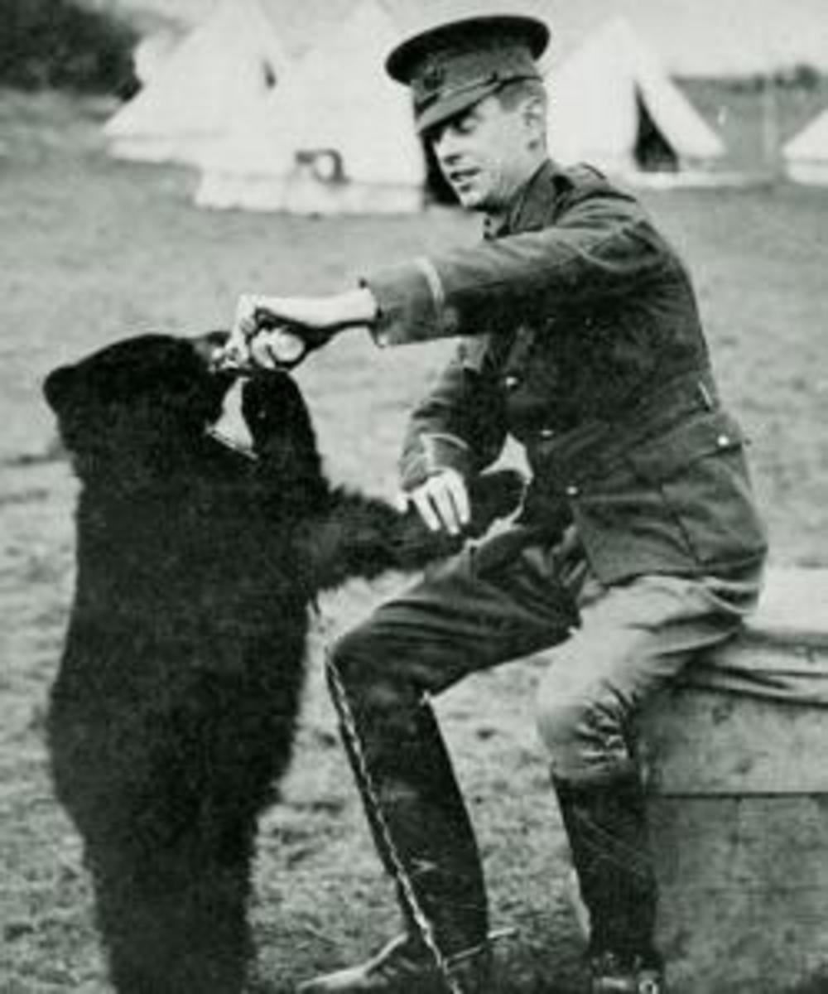
Oh bother…
Some battlefield mascots were on the strange side. Pictured here is Sergeant Colbourn with Winnie, the Manitoban Black Bear cub who was adopted and quickly became the mascot for Fort Garry Horse Regiment. Winnie would inspire A.A. Milne to write Winnie the Pooh.

Slide 14
Conclusion
While the Great War had many great leaps in technology, animals were still front and centre in the fight. Whether it was in the combat roles of soldier rescue, bringing supplies through the muddy terrain of the front, or giving company to wounded and hopeless soldiers, you could be sure to find furry friends doing their part.

Slide 15
Works Cited
Image Number) MLA Citation
1, 6) Author Unknown. Gibby the Canadian Mascot. London News Press. https://www.agefotostock.com/age/en/Stock-Images/Rights-Managed/MEV-10825981. Retrieved: December 06, 2019
2, 7) Metcalf, G.. Man’s Best Friend. Canadian War Museum. https://www.warmuseum.ca/firstworldwar/objects-and-photos/photographs/life-at-the-front-photographs/mans-best-friend/?back=306. Retrieved: December 06, 2019.
3,4) Knapp, J. Animals at War. Canada's Great War Album. https://greatwaralbum.ca/Great-War-Album/About-the-Great-War/Animals-in-war. Retrieved: December 06, 2019
5,8) Metcalf, G. Life at the Front. Canadian War Museum. https://www.warmuseum.ca/firstworldwar/objects-and-photos/photographs/life-at-the-front-photographs/protecting-soldiers-and-horses/. Retrieved: December 07, 2019.
9) Klien, C. The True Story of the Real Life Winnie the Pooh. History. https://www.history.com/news/the-true-story-of-the-real-life-winnie-the-pooh. Retrieved: December 09, 2019.

Slide 16
What you need to do now
Use the resources in the room to decide on a research topic.
Textbook, Ms. Martin’s Library, or your own personal device
Let me know what your topic is, and if you have one, your research question.
Use the remainder of class time to do more research on your topic, write down some useful websites.

Slide 17
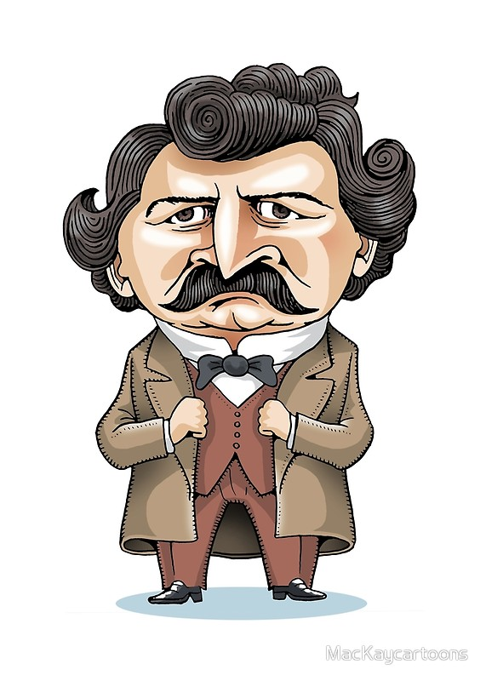
3.1 Metis Resistance possible topics
Louis Riel, traitor or hero
The Metis Bill of Rights
The execution of Thomas Scott
Metis life before and after the resistance
The Battle of Batoche and its impact
Views on Riel, then and now

Slide 18
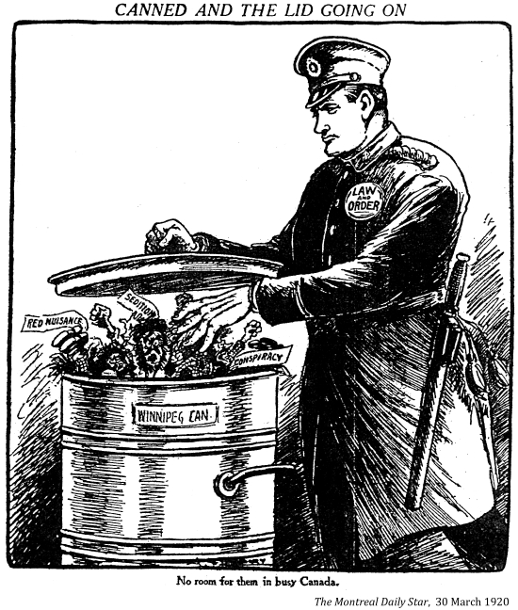
3.2 Canada after confederation possible topics
Immigration to Canada
Ukrainian
Mennonite
German
Chinese
Immigrants living in Canada
Canadian Pacific Railway and its impact on Canada
The Klondike Gold Rush
Rooster Town (Metis town in Winnipeg)
Building Winnipeg in the 1900’s
Winnipeg's North End and immigration
Winnipeg General Strike
Women and the Strike
Leaders of the Strike
Government and the Strike

Slide 19
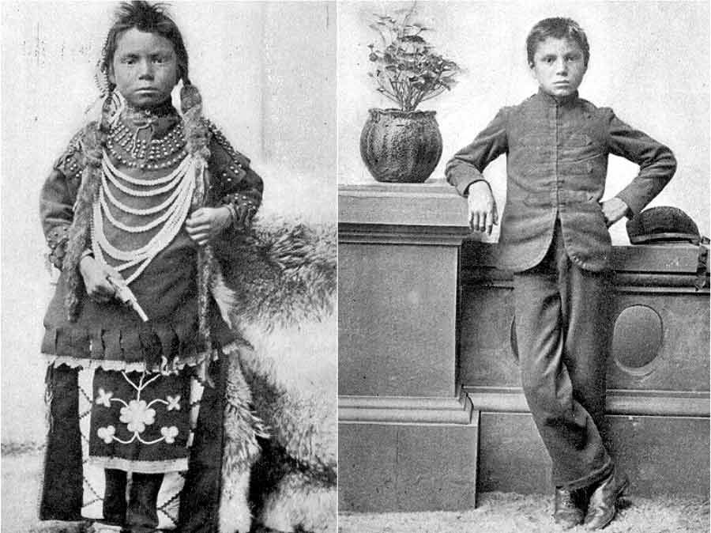
3.3 Indigenous life after confederation possible topics
Treaties: the good and the bad
Metis life after confederation
The Indian Act
Assimilation and the Indian Act
Indigenous soldiers and the Indian Act
The Indian Act and how it changed Indigenous culture
Residential School and its impact on Indigenous peoples

Slide 20
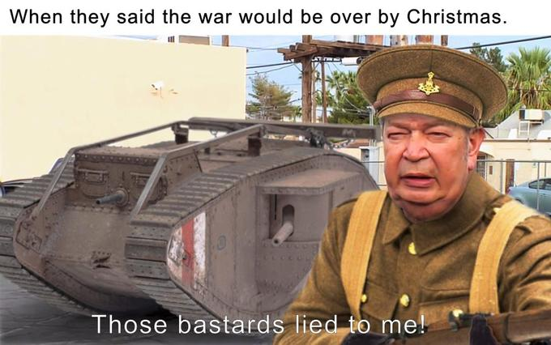
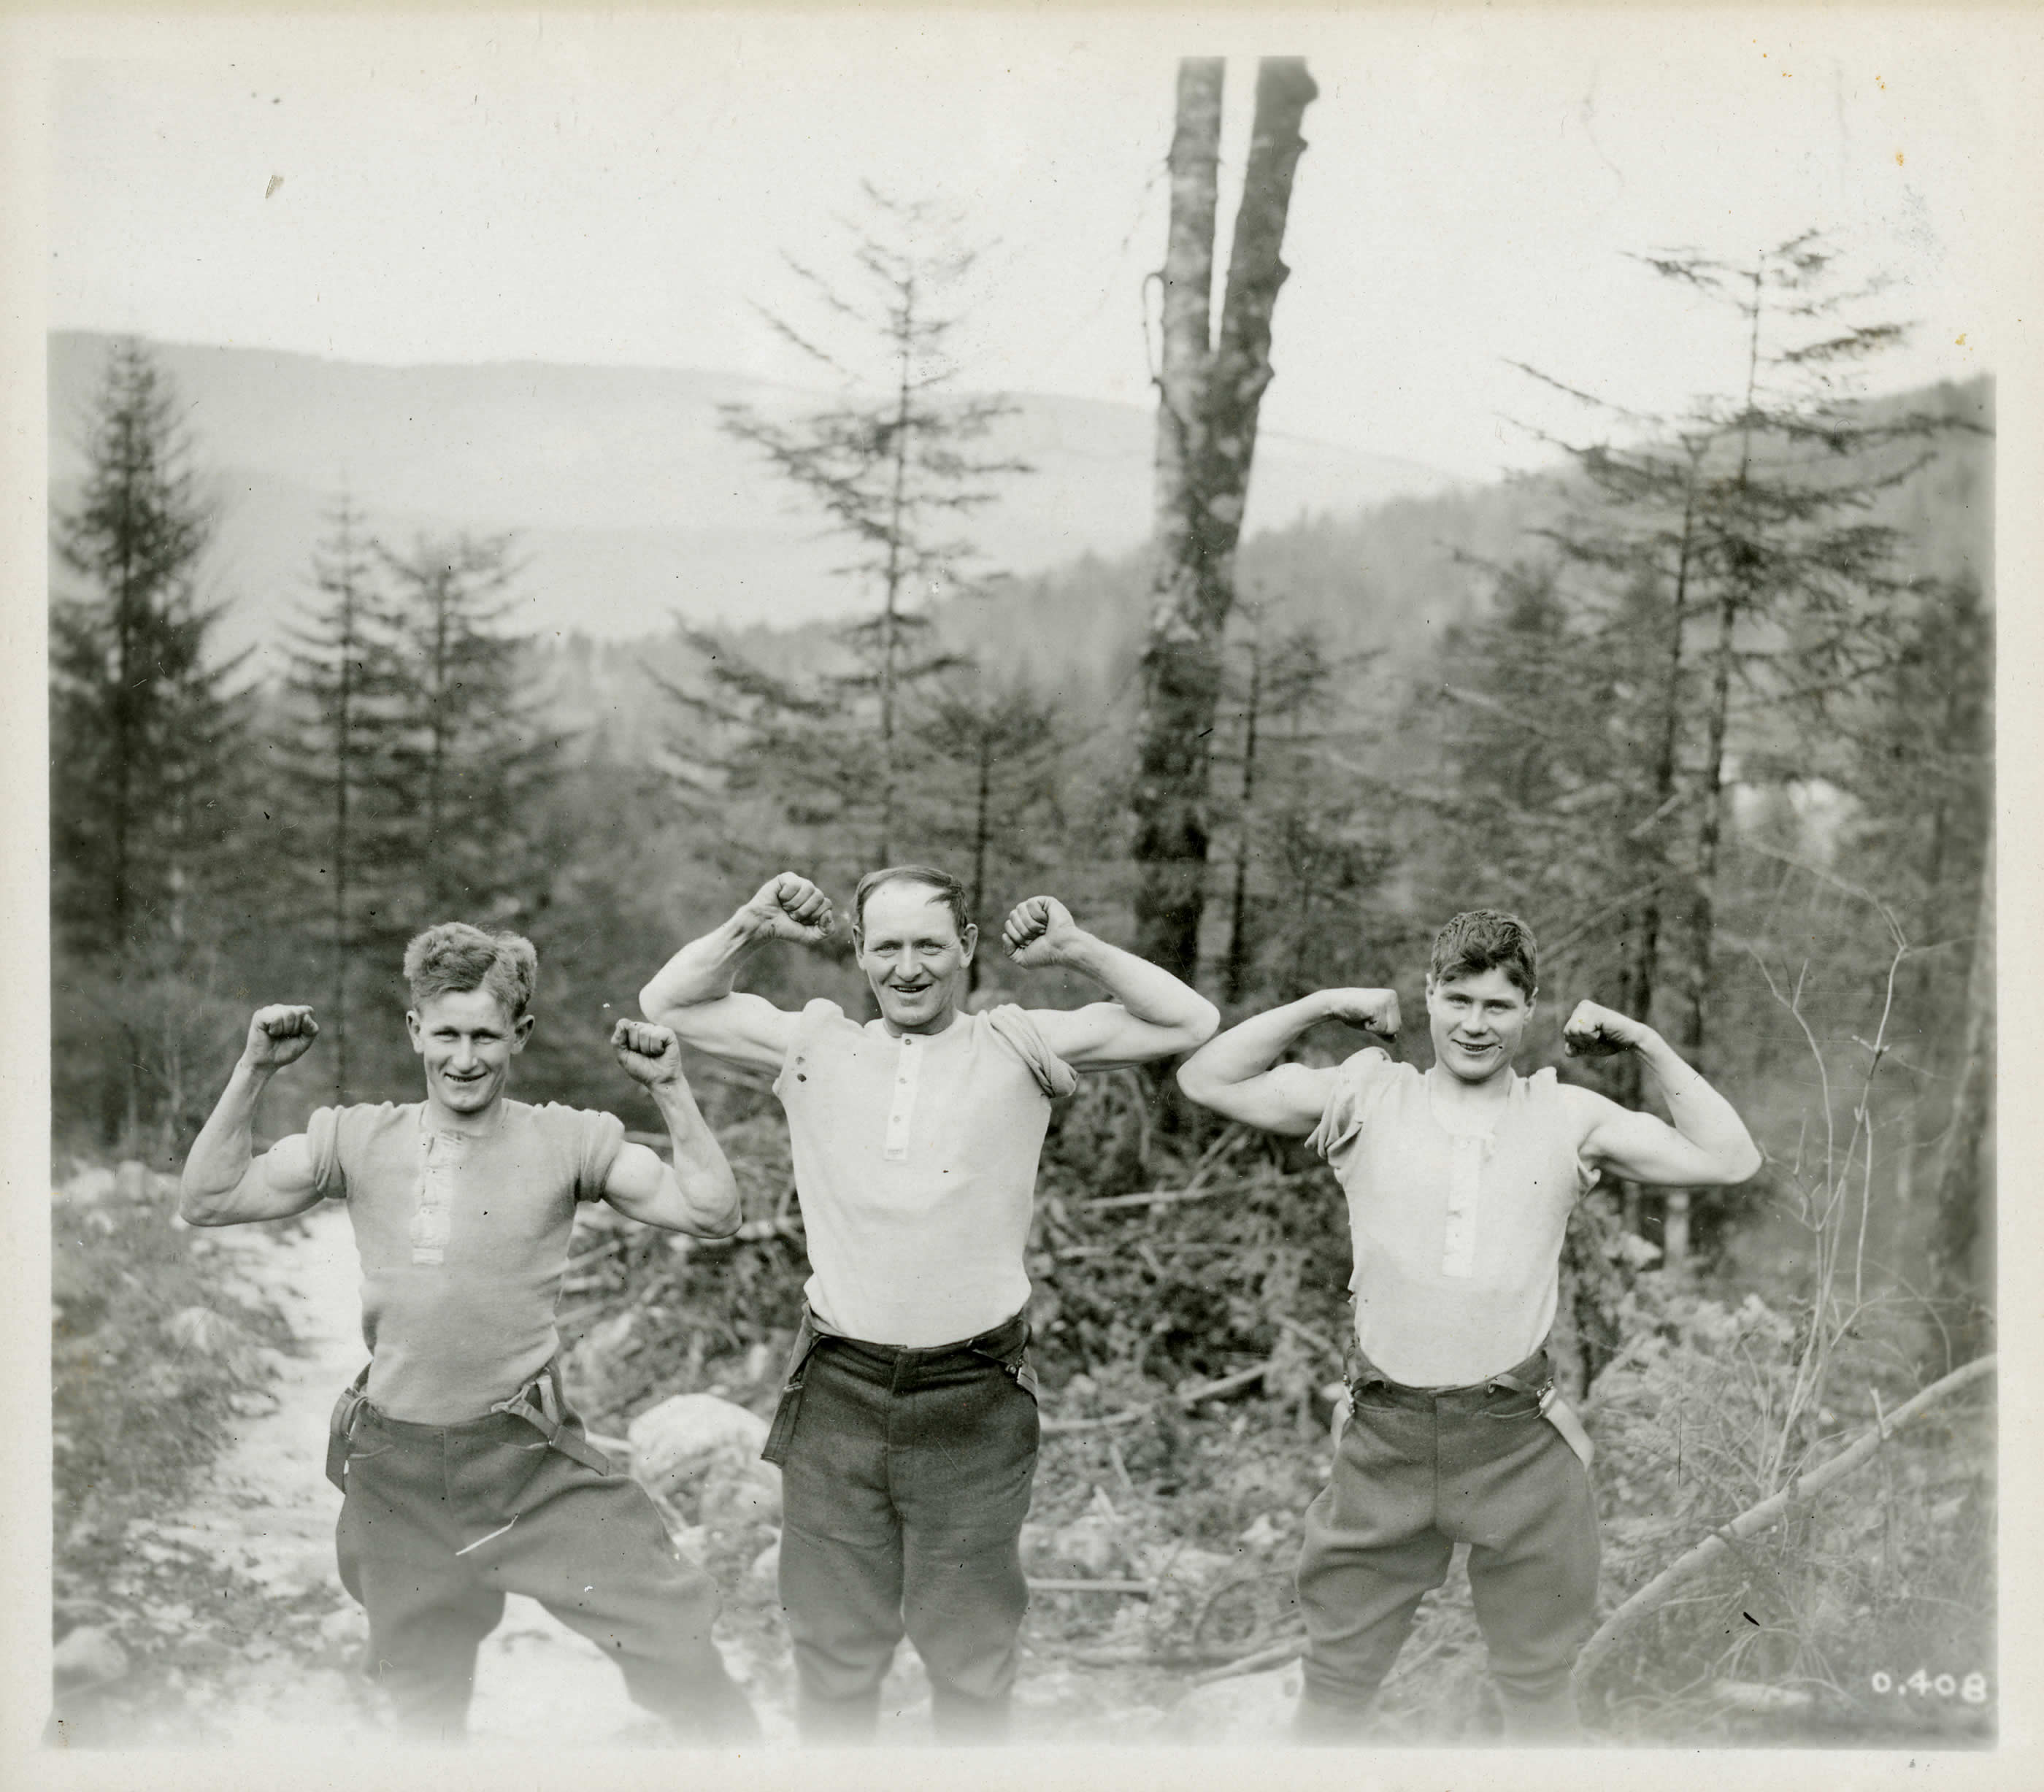
3.4 Canada and the Great War
Canadians and why they went to war
Canadian propaganda during the war
How soldiers lived in the trenches
Soldiers activities when not fighting
Trench humour and theatre
Canada’s greatest battles in the Great War
Canadian Monuments and remembrance
Changing technology in Canada’s military

Slide 21
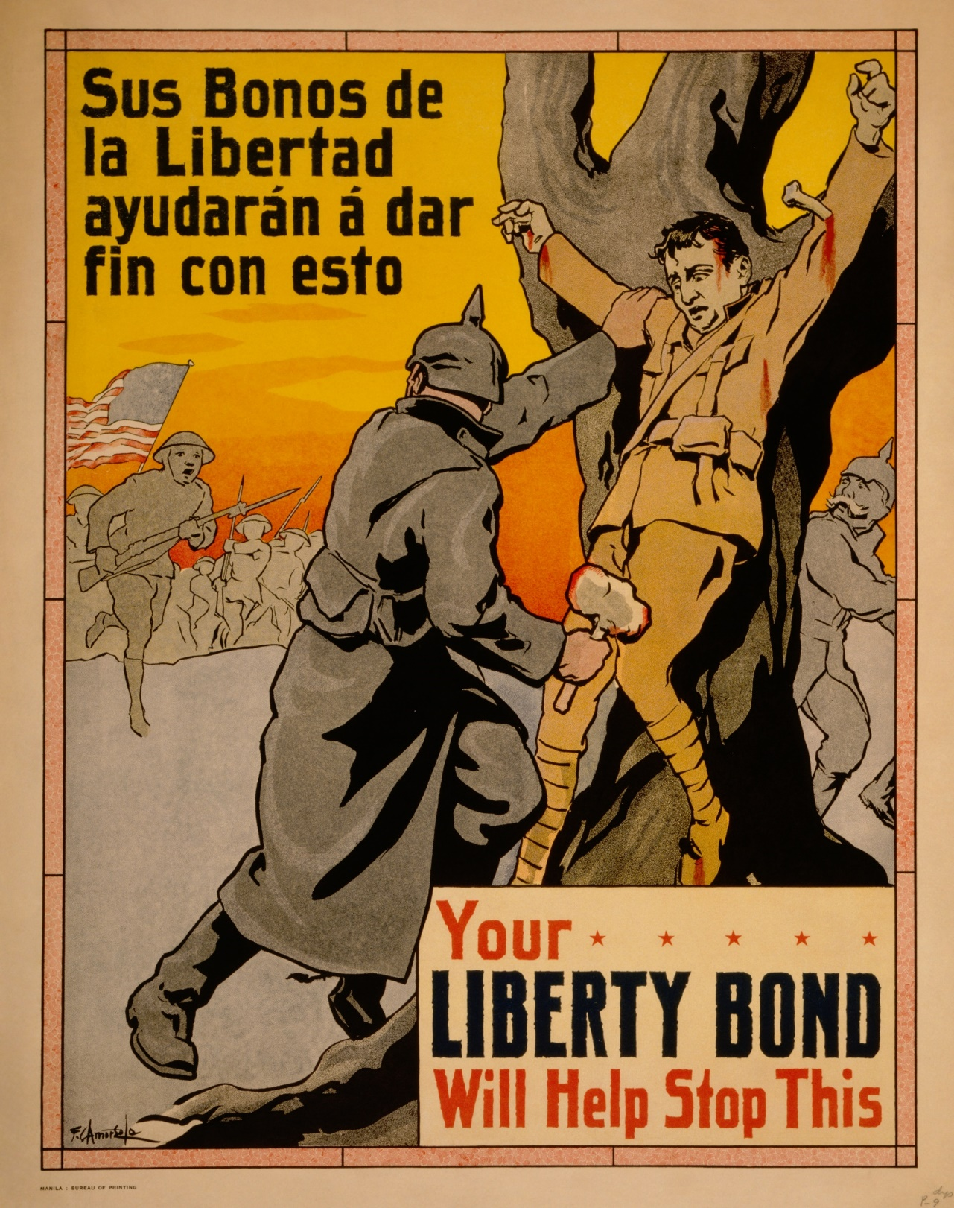
3.4 Canada and the Great War
The Crucified Soldier: Real or Not?
Canadian Nurses at Wartime
The Homefront
Billy Bishop and Canadian War Pilots
Recruitment and Conscription
Enemy Aliens? Internment during the war

